Slide 1
IoT-Powered Pest Detection
Empowering Farmers with Real-Time Pest Monitoring

Slide 2
Table of Contents
Overview: IoT-Based Pest Detection in Agriculture
Project objective
Importance of the Project
Understanding the problems
Arduino
Future Scope
Conclusion
References and Citation

Slide 3
IoT-Based Pest Detection in Agriculture
Insects and Rodents have always been a nuisance for farmers. They feed on their efforts and infest on crops to spread various diseases. Controlling and maintaining their population is therefore important for a farmer to ensure crop health.
Pesticides and insecticides have played a major role in preventing infestations. However, they pose different environmental and social consequences. Extreme use of pesticides can result in severe water & soil contamination and can also intoxicate plants with harmful chemicals. Additionally, insects and bugs become reluctant against them with continuous exposure that forces farmers to rely on heavier pesticides. Even though other methods like genetic seed manipulation are also being used to make crops more robust against the pest attack, they are quite expensive for practical application.
Execution of Internet of Things in the agriculture sector has brought in a major development related to on-field pest management. A farm owner can now use different sensors to monitor the growth of pests and take further countermeasures to manage them. Below is a list of different sensors that are being used to identify and track the growth of insects.

Slide 4
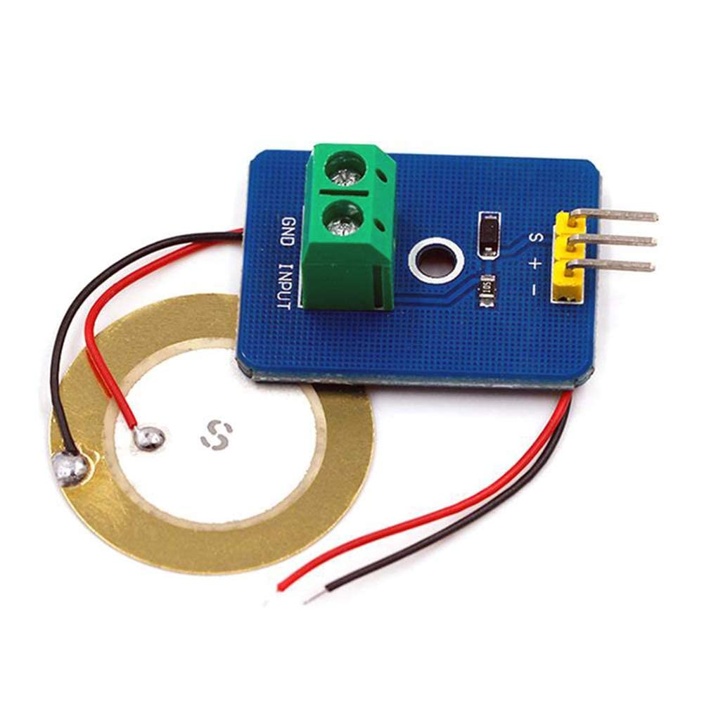
Piezoelectric Sensors (Vibration Sensor)
A device that uses the piezoelectric effect, to measure changes in pressure, acceleration, strain or force by converting them to an electrical charge. These can most probably detect vibrations caused by insect movement or sound since it can detect subtle stimuli.
The piezoelectric effect is the ability of certain materials to generate an electrical charge when mechanical stress is applied to them. Piezoelectricity is a phenomenon which means that there is a coupling between the electrical and the mechanical state of the material.

Slide 5
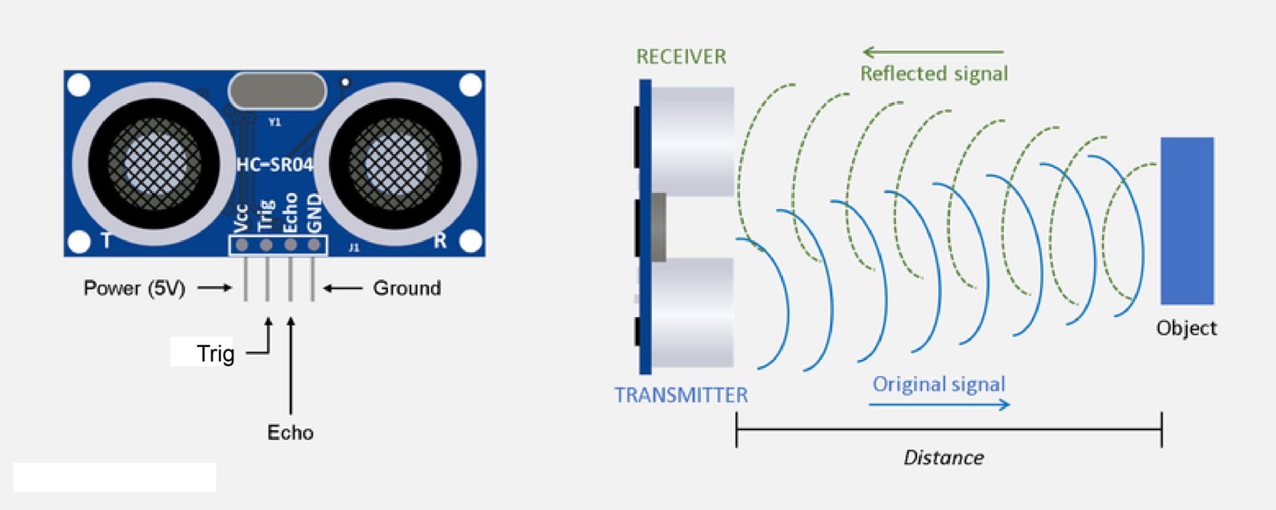
Ultrasonic Sensors (Acoustic Detector)
An instrument that measures the distance to an object using ultrasonic sound waves. An ultrasonic sensor uses a transducer to send and receive ultrasonic pulses that relay back information about an object’s proximity. Many insects, like bats and certain types of mosquitoes, communicate or emit sounds at ultrasonic frequencies (above the range of human hearing)
Ultrasonic sensors work by sending out a sound wave at a frequency above the range of human hearing. The transducer of the sensor acts as a microphone to receive and send the ultrasonic sound. Ultrasonic sensors use a single transducer to send a pulse and to receive the echo. The sensor determines the distance to a target by measuring time lapses between the sending and receiving of the ultrasonic pulse.

Slide 6
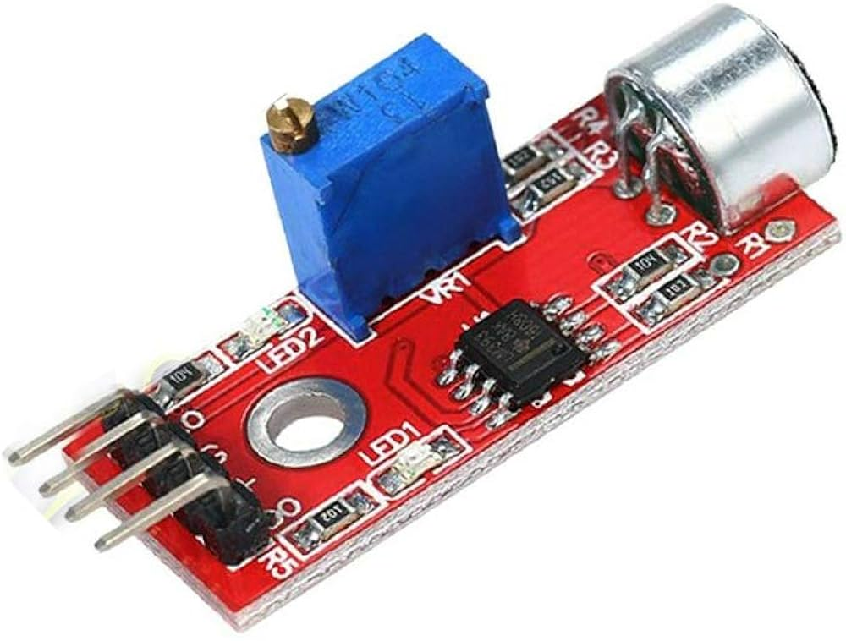
Sound Sensor Module (Acoustic Detector)
Sound sensor is used to receive acoustic wave and display the vibration image of sound. It has a build-in capacitively electret microphone that is sensitive to sound. The electret fil min microphone vibrates with the acoustic wave resulting in the change of capacitance and the subsequent micro voltage

Slide 7
Other Sound/Frequency Sensors:
01
Shotgun Microphones (Acoustic Detector)
02
Radar and LiDAR Systems (Electromagnetic Frequency Detector)
03
Bioacoustic Sensors (Electronic Ears)

Slide 8
Project objective
Develop a Robust IoT System
Enhance Precision in Pest Monitoring
Provide Real-Time Alerts and Data to Farmers
Improve Agricultural Efficiency and Sustainability
Expand the Scope of IoT in Agriculture

Slide 9
Importance of the Project
Reducing Crop Losses
Minimizing Pesticide Use
Supporting Sustainable Agriculture
Empowering Farmers with Technology

Slide 10
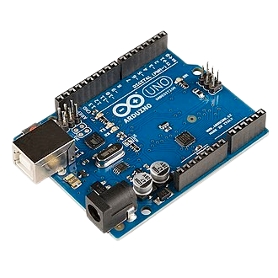
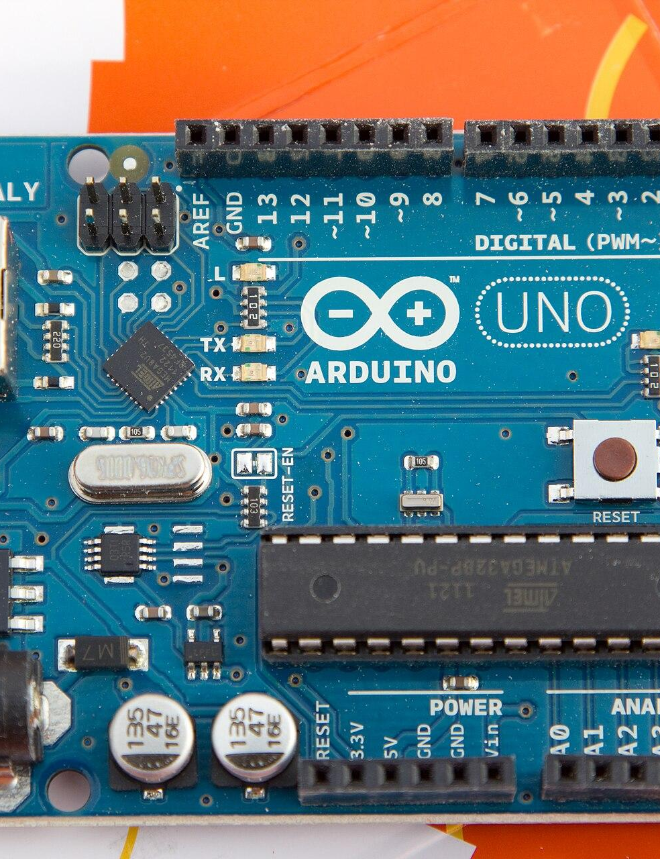
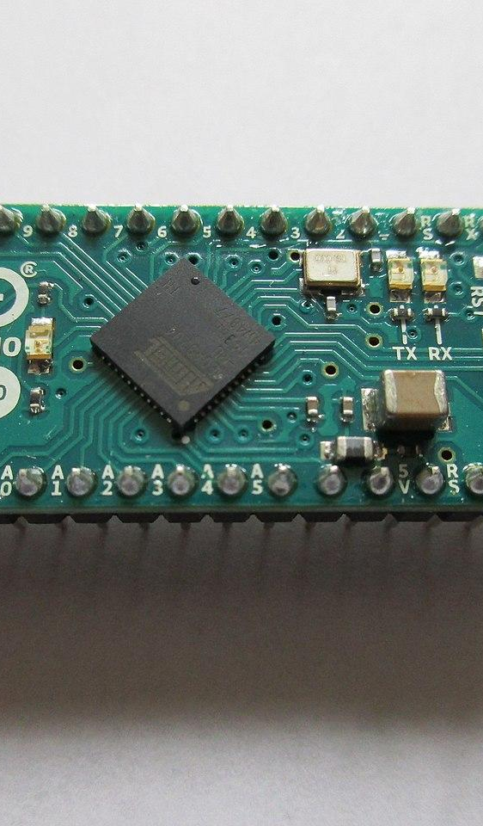
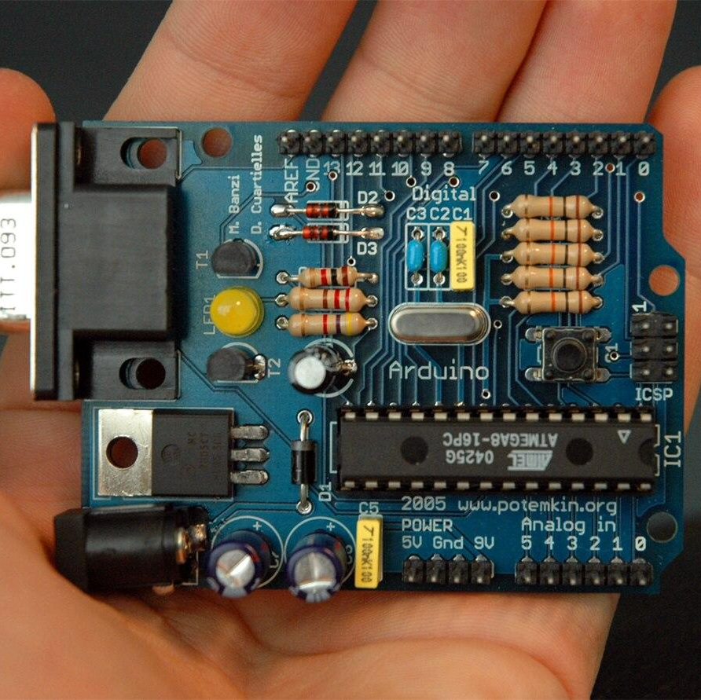
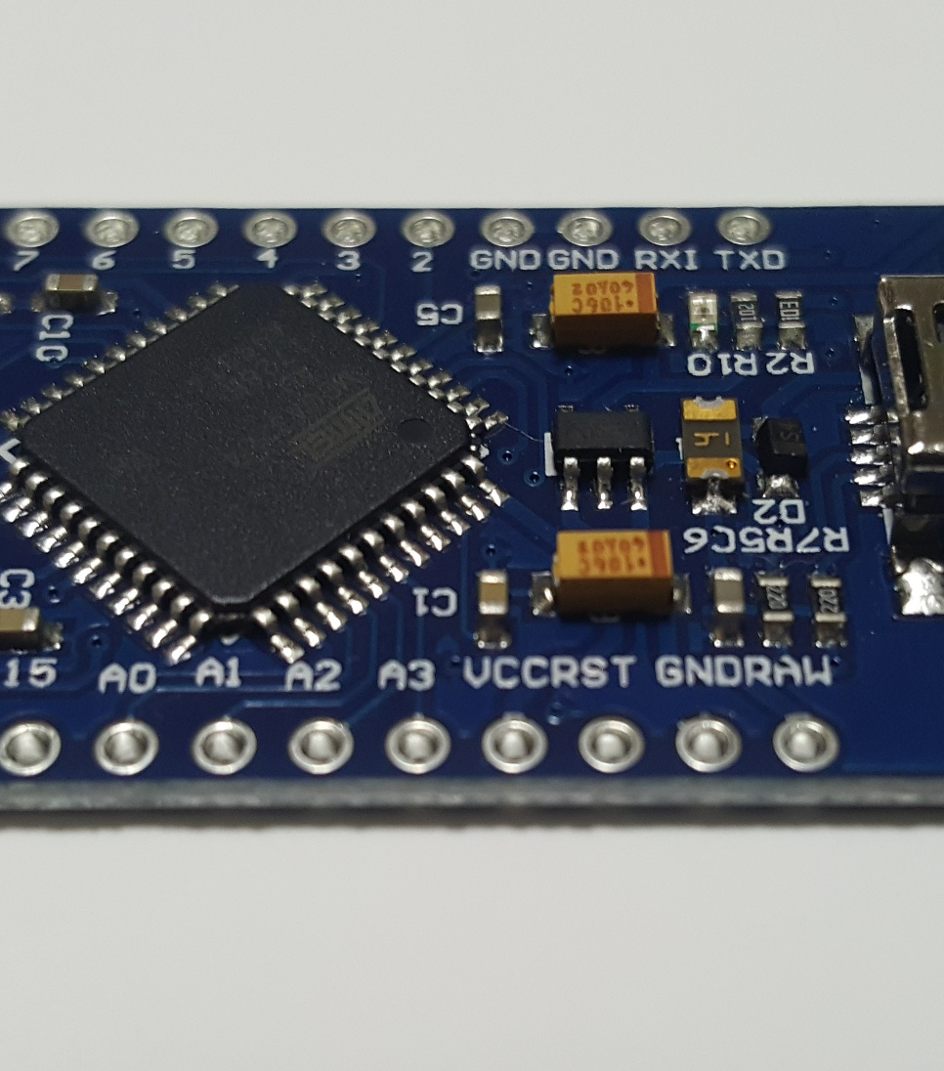
Arduino: The Farmer’s New Best Friend
Open-source electronic prototyping platform enabling users to create interactive electronic objects.
Arduino is an open-source electronics platform that simplifies the process of creating interactive projects. It consists of a microcontroller and software that allow users to easily program and control various sensors and devices. Arduino is popular for its versatility and ease of use, making it ideal for everything from beginner projects to advanced IoT applications.
Fun Fact!
The name "Arduino" comes from a bar in Ivrea, Italy, where the founders used to meet.

Slide 11
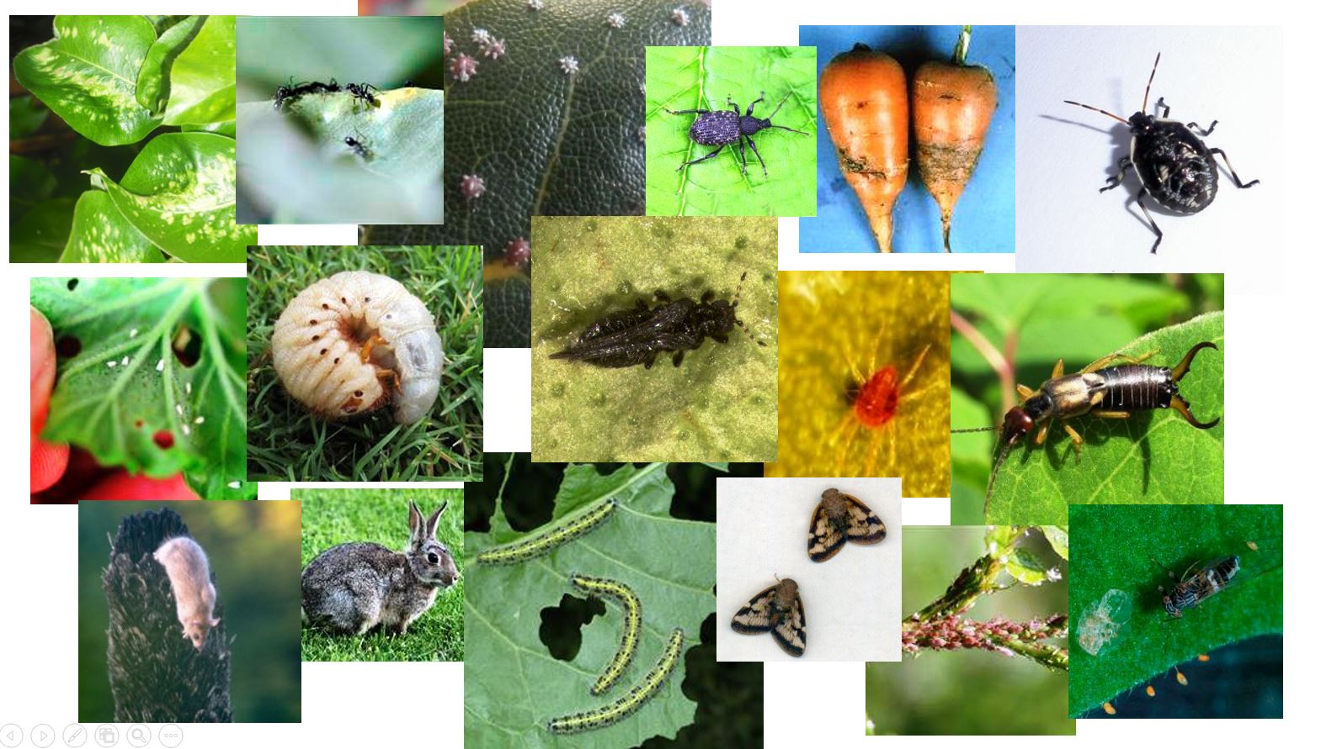
Buzz & Beat: The Secret Sounds of Nature
Insects play a significant role in the agricultural ecosystem, but not always in a beneficial way. Insects can cause significant damage to crops by feeding on plants and spreading diseases, often leading to reduced yields and economic losses for farmers.
While these pests communicate through sounds that are typically undetectable amidst farm noise, leveraging technology to monitor these acoustic signals could enable early detection of infestations, allowing for more timely and effective pest control.

Slide 12
Understanding the problems
01
Sensor Accuracy and Calibration
02
Power Supply and Energy Efficiency
03
Maintenance and Durability
04
Cost and Economic Viability
05
Data Transmission and Connectivity

Slide 13
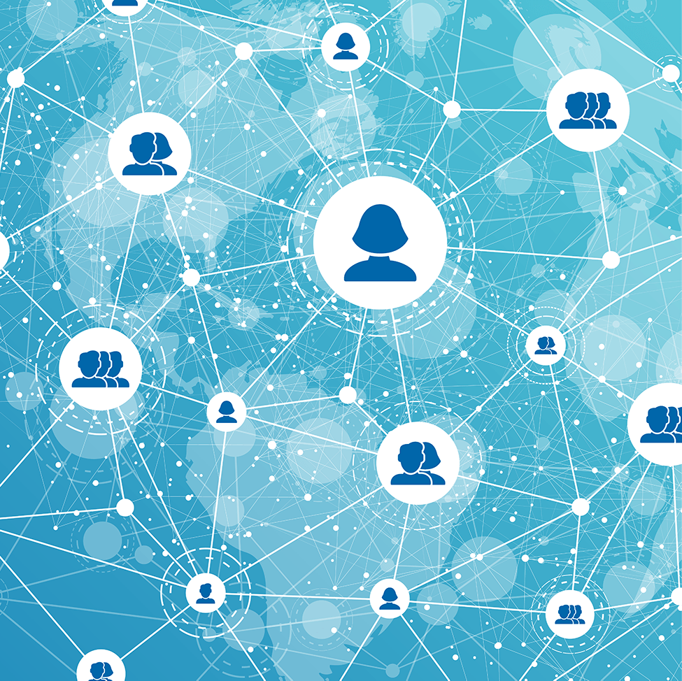
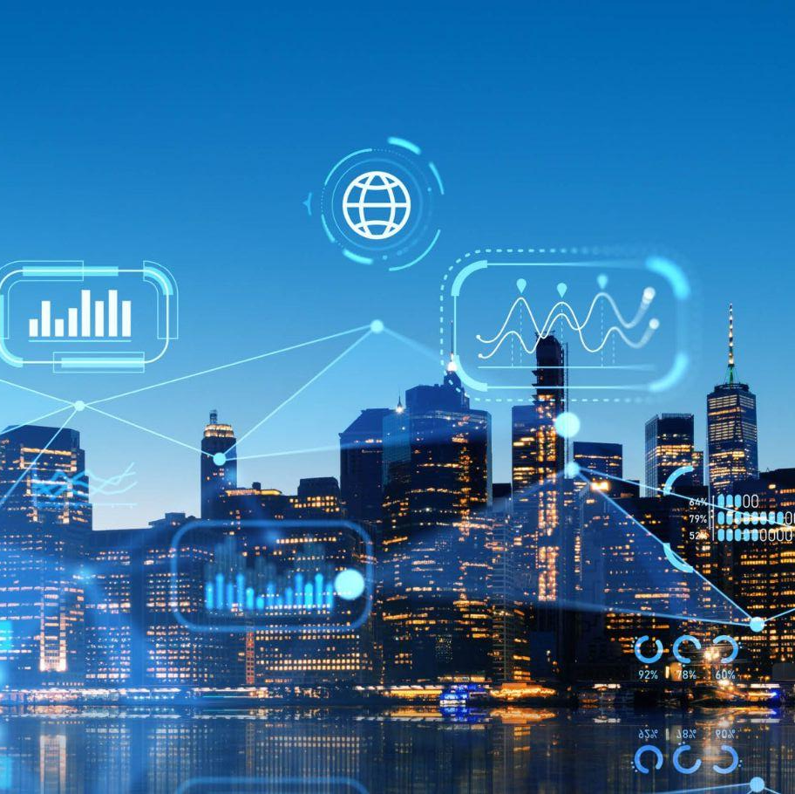
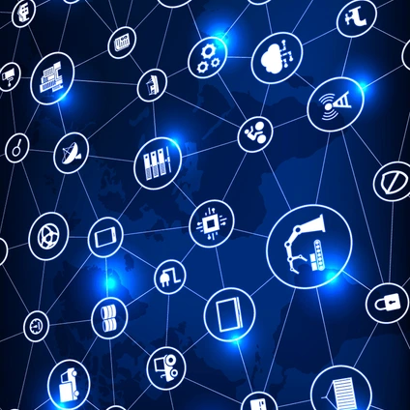
Future Scope
01
Educational and Research Opportunities
02
IoT-Enabled Ecosystem for Pest Control
03
Integration with Other Smart Farming Technologies
04
Environmental and Sustainability Impact

Slide 14
Conclusion
This project proposes an IoT-driven solution for real-time pest detection in agriculture, aiming to reduce crop losses and promote sustainable farming practices. By integrating advanced sensors and microcontrollers, the system offers precise, actionable insights that empower farmers to make timely interventions, minimizing pesticide use and enhancing crop health.
Looking ahead, the system’s potential for integration with other smart farming technologies and expansion across different crops and regions positions it as a key tool in the future of precision agriculture. With continued development, this project could significantly advance the role of IoT in transforming agricultural practices, contributing to both environmental sustainability and food security.

Slide 15
References and Citation
01
Dr. Trigunesh Narzary (Mentor)
02
https://www.arduino.cc/
03
https://www.youtube.com/
04
https://en.wikipedia.org/
05
https://maxbotix.com/
06
https://www.makerspaces.com/
07
https://www.biz4intellia.com/
08
https://www.tinkercad.com/

Slide 16
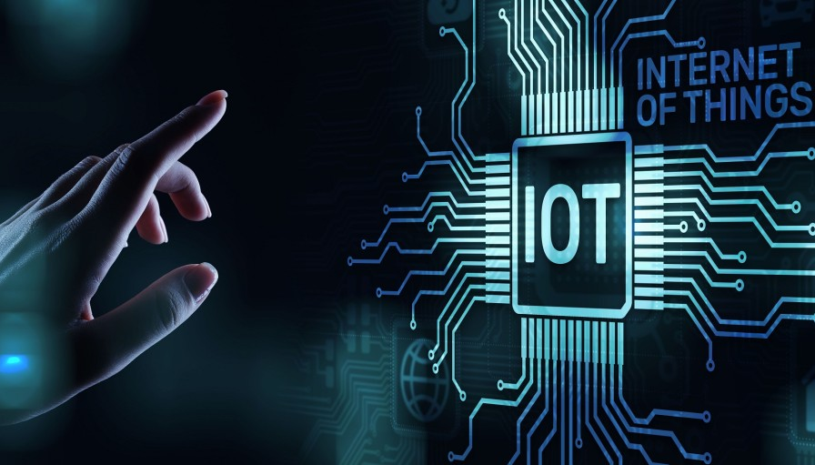
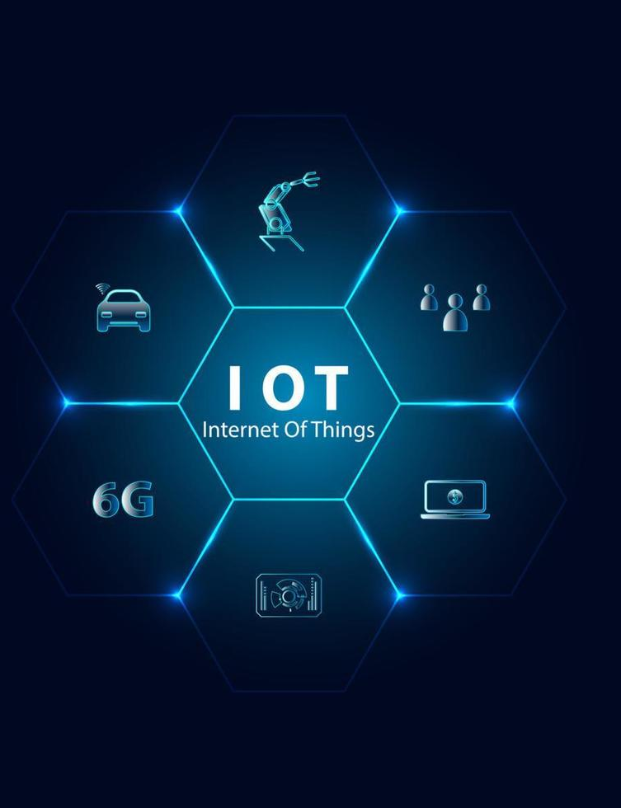
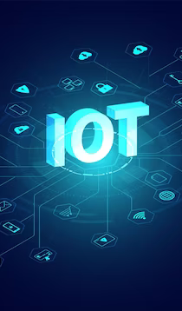
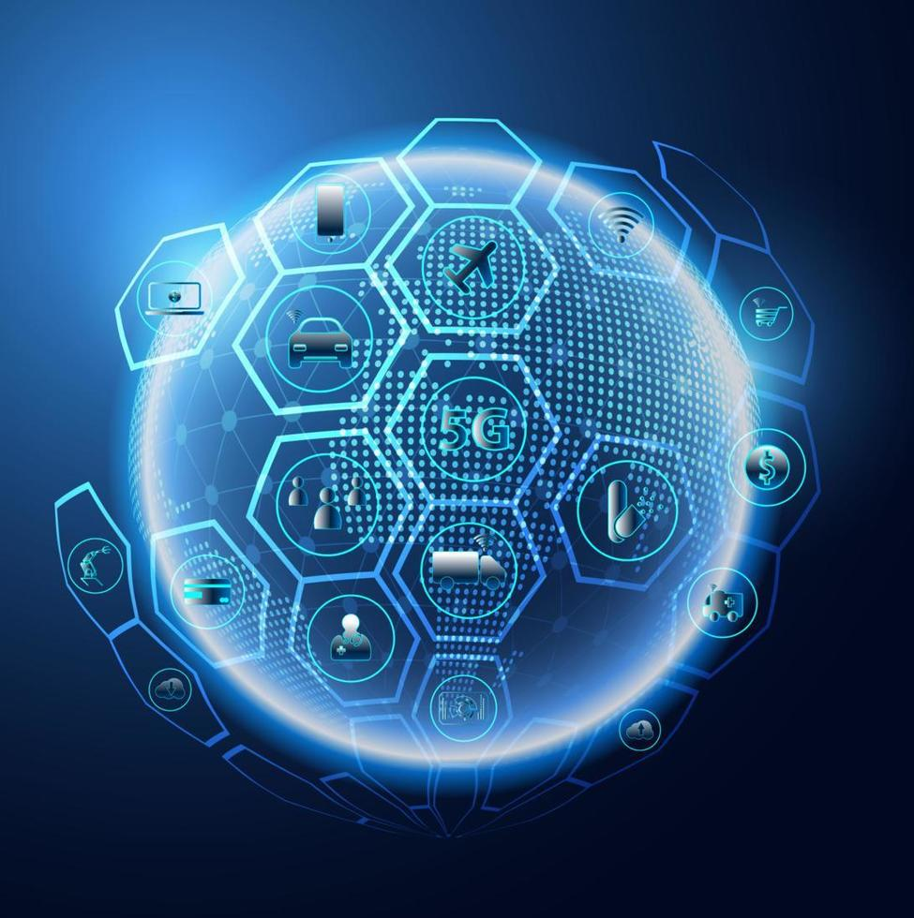

Thank you!
For your time and attention.
Any Questions?

